Slide 1

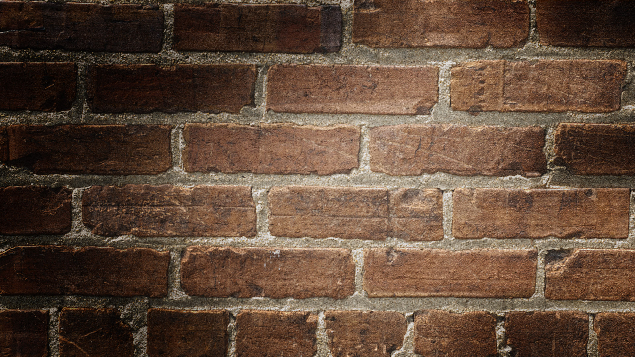
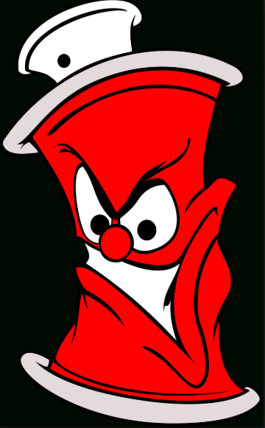
American Street art
Travis Mayo
Columbia Southern University
10/16/2018

Slide 2
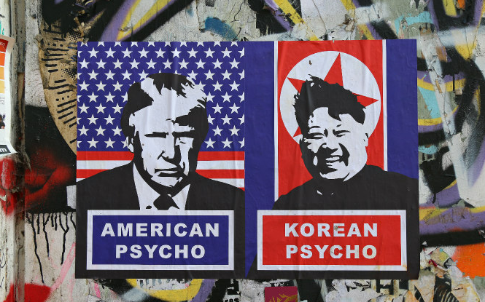
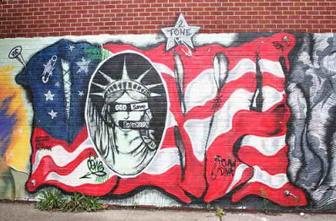
American Street art
I have always been fascinated with street art and graffiti.
It is my favorite form of artistic expression second to music.
Now, I am no artist by any means, but to me graffiti is a rebellious form of making a statement or sending a message and street art brings life to plain walls, tunnels, and alleys.
In my opinion graffiti and street art means a more colorful world, or more interesting scenery, and adds character to our country.
It makes for a scenic ride to work or walk around the block.
I Look forward to learning more about how artist do street art, what medium do they use, and how that challenges them in their work.

Slide 3
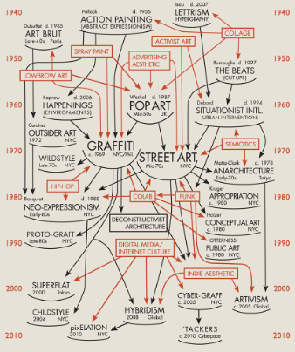
American Street art
Street art has been around for many years, as early as the time of our ancestors who’s form of street art was done on cave walls and with soot or charred wood/bone.
Evolution of street wall moved to graffiti and through to the 21st century evolved in to much more.
The evolution of street art evolved into interdisciplinary forms of artistic expression from graffiti, stencils, prints, and murals.
The movement of street art even includes large scale paintings and projects artist collaborating. (Bojan, and Maric (2014).

Slide 4
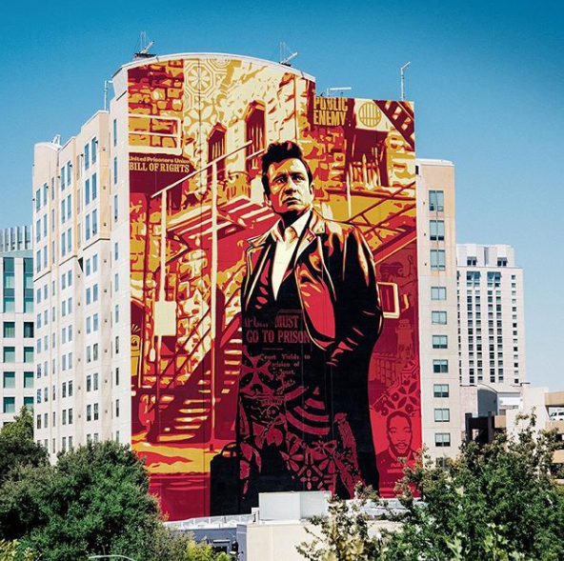
Tribute for the 50th anniversary of Johnny Cash’s Live at Folsom Prison album
Shepard Fairey
8/20/2018
Paint
(Fairey, 2018)
Notes:
Include citation

Slide 5
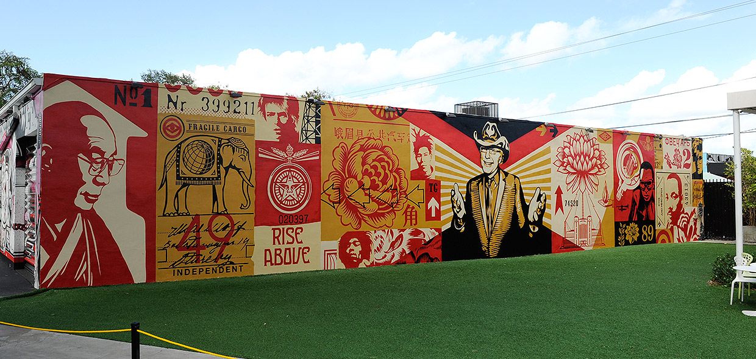
Tony goldman mural
sheppard fairey
wheat paste – 12/03/2012
(Fairey, 2012)

Slide 6
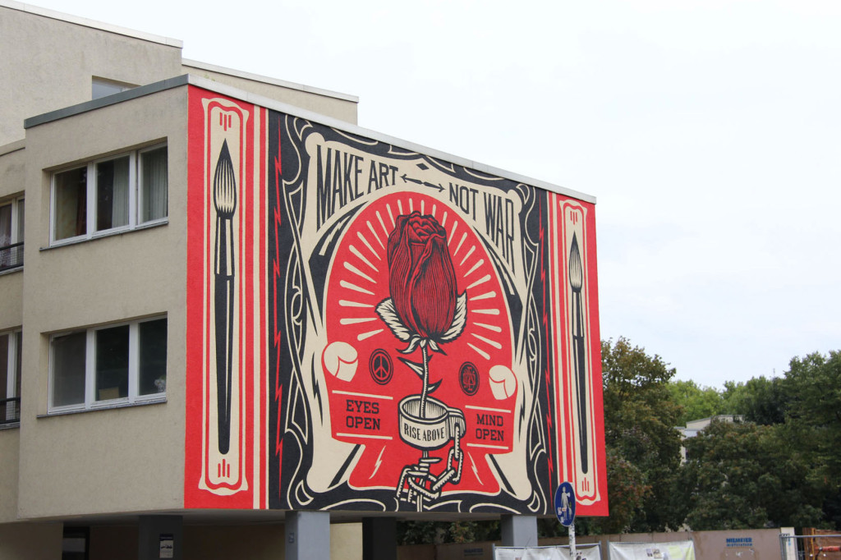
Make art not war
Shepard Fairey
September 2014 paint
(Fairey, 2014)

Slide 7
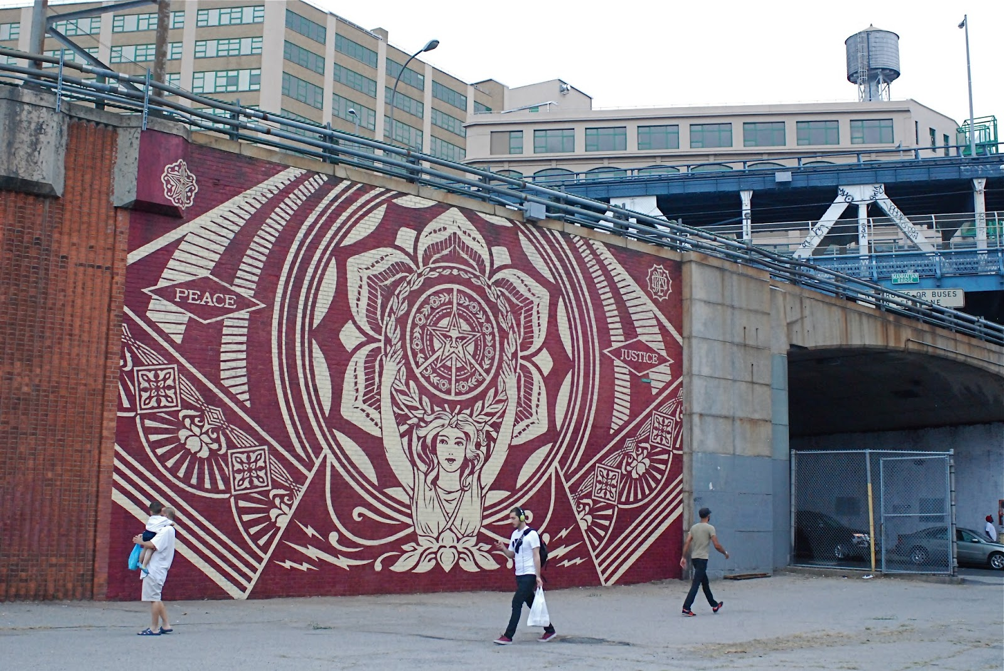
Dumbo nyc mural
8-16-2013
shepard fairey
paint
(Fairey, 2013)

Slide 8
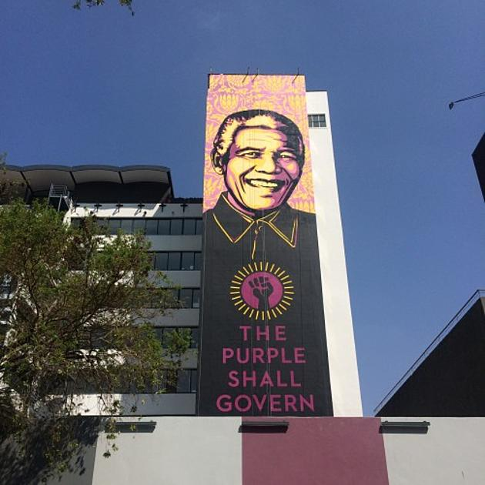
Nelson mandela mural
Shepard Fairey
September 2014 paint
(Fairey, 2014)

Slide 9
Tribute for the 50th anniversary of Johnny Cash’s Live at Folsom Prison album
Visual Elements:
Line: There are a combination of thick and thin lines horizontal and vertical on the stairway, scaffold, and balconies portrayed in the mural
Shape: You will notice rectangle shapes in the scaffold, circular shape in the face of Johnny Cash and more square shapes in the windows
Light: light is coming from the backdrop on the building with Johnny cash painted in a darker tone in the front of the mural
Color: You will see a combination of orange & red hue fades along with black and a yellowish tan color which can also be a shade of orange.
Texture: no noticeable pattern, but possibly an impasto application due to the application on ta building wall.
Mass: The artwork is heavier with the noticeable black on Johnny cash

Slide 10
Tribute for the 50th anniversary of Johnny Cash’s Live at Folsom Prison album
Unity: The picture of Johnny Cash captured at Folsom prison is integrated with a city background, this integration looks complete and natural.
Variety: Diversity is captured in the color tints and blacks applied to the mural
Balance: the mural asymmetrical because Johnny cash is offset, and the background building covers the right side of the mural
Emphasis: focal point of the mural is Johnny cash
Directional forces: paths of the mural lead to Johnny cash in the middle of the mural
Contrast: contrast is captured in the black of Johnny cash and yellowish orange of the building behind him

Slide 11
Unit 6- Tribute for the 50th anniversary of Johnny Cash’s Live at Folsom Prison album
Color
Color; A mix of colors well blend with the background. Major colors are red, white and green.
Light
Light: The mural is poorly illuminated, such that the focus image cannot be seen clearly
Shape
Shape: While some shapes may be there, they are not clear.
Mass
Mass: The John’s cash is the central focus of the mural, strategically at the centre.
Texture
Texture: not clear patterns can be noticed, especially with given the thick color used

Slide 12
Unit 5- critique 2. Tribute for the 50th anniversary of Johnny Cash’s Live at Folsom Prison album
Shepard Fairey
8/20/2018
Paint
(Fairey, 2018)
Notes:
Include citation

Slide 13
Tony goldman mural
Visual Elements:
Line: Describe The lines in this artwork move at an angle behind Tony Goldman, or from behind Tony to the front of the painting. Also straight horizontal lines on Tony’s jacket.
Shape: There are rectangular shapes behind Tony that form an array or light appearance coming from behind or to Tony.
Light: The Lightest portion of this painting would be in Tony’s face, hands, and in between the rectangles behind Tony.
Color: The colors used in this painting are shades of orange Hue, red, and black.
Texture: There is patterns of rectangles behind Tony
Mass: Is the artwork is heavier in at the bottom and the top of the photo because the artist uses black and then fades into the portrait.
Motion: no motion is portrayed in this picture.
(Fairey, 2012)

Slide 14
Unit 4- 2. Tony goldman mural
Design Principles:
Unity: The tony at the centre of the mural creates image connects.
Variety: different objects have been used comprising of other persons, numerals and animals et al.
Balance: symmetry is not maintained given the different intensity of the objects used.
Emphasis: The emphasis may be noted to be on Tony who is the biggest image in the mural, posing a question gesture.
Directional forces: There are no directional forces in the mural.
Contrast: there is no contrast in the mural, given different messages displayed in the mural.
Repetition & rhythm: There are no elements of repetition in the artwork
Scale & proportion: The objects are not symmetrically proportional to each other

Slide 15
2. Unit 6- Tony goldman mural
Light
Light; well lit, the color is bright for the mural.
Mass
Mass; Tony is the major object of focus in the mural.
Texture
Texture; seemingly a rough texture
Color
Color; The red, white, black and green colors are dominant.
Shape
Shape; diversified shapes are used for different object, e. g animals, power, bucket et al.

Slide 16
Unit 5- critique 3. Tony goldman mural sheppard fairey wheat paste – 12/03/2012
(Fairey, 2012)
Notes:
Include citation

Slide 17
Make art not war
Visual Elements:
Line: The Lines in this painting are visible moving outward from the center Rose, and circular shaped throughout the mural
Shape: You will notice circular shapes in the body of the rode, the shackle, amidst the framing of the mural, and the teo small emblems to the right and left of the flower.
Light: The lighter colors are along the framework of this murals with the white, but the white lines coming from the rose seem to give off the look that the rose is radiating.
Color: Colors used in this mural consist of red, white and black. You don’t see shading in this mural.
Texture: I do not notice an ongoing pattern but do see small patterns in the framing of the mural, the aura around the rose, and the white symbols on each side of the rose.
(Fairey, 2014))

Slide 18
Unit 4- 3. make Art not war
Design Principles:
Unity: the flower with cuffing is critical in uniting the mural
Variety: the use of different objects like flower, cuff, and painting pen
Balance: the mural has symmetrical objects
Emphasis: the cuffs form the point of emphasis which calls for people to rise above crime or imprisonment
Directional forces: the direction of the cuffed flower is to be followed.
Contrast: the call to make art but not war, instead of make peace not war?
Repetition & rhythm: no aspects of repetition noted
Scale & proportion: proportionality is maintained for all the objects used.

Slide 19
Unit 6. 3. make art not war
Light; the mural is colorful
Mass; the flower takes the central focus of the mural
Color; the red, white and black colors are dominant
Shapes; no specific shapes of the objects are capital in the mural
Line; there are clear lines in the mural
Texture; clear patterns are traceable.

Slide 20
Unit 5- 4. Make art not war
Shepard Fairey
September 2014 paint
(Fairey, 2014)
Notes:
Include citation

Slide 21
Dumbo NYC mural
(Fairey, 2013)
Visual Elements:
Line: Describe You will notice diagonal lines forming a star in the middle, on the two rectangular pieces on each side of the mural, and within the two rectangular pieces forming triangles.
Shape: There are circular shapes, rectangular shapes, and triangles scattered through this mural.
Light: No real lighting being portrayed, but the lighter color is the white painted over a maroon color.
Color: There are only two colors used in this mural, a maroon and a white.
Texture: There is a circular pattern and what looks like an Argyle pattern in the middle circle.
Mass: The artwork is balanced between the maroon and white

Slide 22
Unit 4- 4. Dumbo NYC mural
Design Principles:
Unity: the color match make everything else run in unison.
Variety: different shapes are used, combined with a message of peace and justice .
Balance: the mural seems symmetrical in all respects.
Emphasis: the woman at the bottom is the focal point of the mural.
Directional forces: the woman’s hands and the crown that links the mural to the other images
Contrast: while the message is about peace and justice, the mural denotes powers
Repetition & rhythm: the symbols used at the margin of the mural are repetitive all the way round
Scale & proportion: proportionality is eminent for all objects presented in the mural

Slide 23
Unit 6- 4. Dumbo NYC mural
Light; well lit, with purple color.
Mass; the woman form the focal point of the mural.
Shape; crown like objects are used in the mural.
Color; light purple color and white are key colors used.
Line; there are clear lines in the mural.
Texture; smooth texture is eminent.

Slide 24
Unit 5- 5. Dumbo NYC mural 8-16-2013 Shepard Fairey paint
(Fairey, 2013)
Notes:
Include citation

Slide 25
Nelson mandela mural
Visual Elements:
Line: The only noticeable lines I see are along the collar.
Shape: You will see a circular shape with a fist in the middle of the mural, and a circular shape possibly used to start the face.
Light: The lighting is coming from the top of this mural, and it moves into black.
Color: There are purple or lavender colors used, also what looks like a yellowish orange and a lot of black for the shirt in this mural.
Texture: The patterns in this mural are above Nelson’s head and appear to be patterns of a flower in the backdrop.
Mass: The artwork is much heavier on the bottom of this mural which is Nelson’s shirt or jacket.
Time: No sense of time is portrayed
(Fairey, 2014)

Slide 26
Unit 4 -5. nelson mandera mural
Design Principles:
Unity: The unity is brought about by the color match, the purple which take the theme very well
Variety: The theme color of the mural blends well with the horizon, which is catchy
Balance: The mural is quiet symmetrical
Emphasis: The image of nelson mandera
Directional forces: the statement at the bottom
Contrast: The purple shall govern, while no person is purple instead of saying the blacks.
Repetition & rhythm: There is no element of repetition in the mural
Scale & proportion: Proportionality is eminent in the mural in all respects

Slide 27
Unit 6- 5. nelson mandera mural
Light; the blue and purple lights illuminates the mural
Mass: the image of mandera is central this mural
Line; There are clear lines in this mural
Shape; There are some rectangular shapes in the mural, boxes of the same shape are also present.
Texture: clear patterns are eminent. The mural has a smooth texture

Slide 28
Unit 5 help slide- Formal Art Criticism Theories
Each section of the art piece are joined with the rest using lines, that offer transition from one image to another.
Failure to use colourful colors would make the object not attractive to the viewer
The organization of the various objects is predominantly critical in bringing out the core message.
The central object is often made larger than the rest, to catch the eyes of the viewer
Few words/statements are often used, normally less than a sentence., but catchy and insightful

Slide 29
Unit 5 help slide- Contextual Art Criticism Theory
The theme colors is of the essence in an artwork
For example, black and white could denote old age, bright colors may denote recent or contemporary times
The activities enshrined in artwork, greatly express the times in which the artwork represent.
The physical environment may be denoted in artwork,
Various objects may define the culture of the community represented.
Key words help express the values of a given community as represented in a artwork.

Slide 30
Unit 5 help slide- Expressive Art Criticism Theories
There are 3 expressive art criticism theories; formal theories, contextual theories, and expressive theories
Expressive criticism theory treats the artwork in relation to the author
Feelings, emotions, and expressions and utterances of the author are of the essence in the expressive art criticism.
The nelson mandera mural is best expressed by the theory given the strong message that carries emotions and historical tendencies in it.
Emotions are embraced in the artwork of Nelson mandera, especially in the statement, the purple shall govern, then with the free-black-hands.

Slide 31
Unit 8- Comprehensive Statement
Artwork help create awareness in the society, inspire and motivate the people into doing good
Artwork makes the surrounding colorful, adding the aesthetic beauty.
Artwork provides emotions, feelings and sense to the community, leading to changes of perceptions, understanding and personality.
Some artwork also carries some sense of humor, fun making
The art criticism theories are crucial in helping people understand the artwork, as well as appreciate
Effective use of art criticism theories can lead to a united state, since the artwork sends strong messages that can render a nation more cooperative, alienating from evil

Slide 32
Unit 8- for each artwork Comprehensive Statement
Tribute for the 50th anniversary of Johnny Cash’s Live at Folsom Prison album, denote the significance of freedom. It consoles that anybody can go to prison, its fate to decide.
Tony goldman mural Shepard Fairey wheat paste, is expressive of a community that keeps moving ahead irrespective of the prevailing circumstances.
The Make art not war Shepard Fairey is a strong call for people to live in peace and alienate their lives from being held captives.
The Dumbo NYC mural emphasis on the need for peace and justice in the society , where political leadership ought to take leadership of the cause.
The nelson mandera mural, communicate the need for people to stay woke, for a new governance, seemingly after the apartheid rule in South Africa.

Slide 33
Unit 8- Comprehensive Statement
Artwork should be highly encouraged to spread message to the nation
The artwork can be used to bring about a revolution where embraced seriously
The artwork, especially the street wall art, communicate much easily and convincingly as opposed to other forms of writing.
Artwork such as the murals use simple and clear images and words catching the viewer’s eyes
The nelson mandera mural is both satirical, yet very powerful message is presented.
Many of the artwork criticized in this PowerPoint relates the recent matters in the society

Slide 34
References
Bojan, Maric. Widewalls, retrieved from: https://www.widewalls.ch/the-history-of-street-art/
DUMBO Walls Project Featuring New Street Art By Shepard Fairey And Other Artists. (n.d.). Retrieved from http://nyclovesnyc.blogspot.com/2013/08/dumbo-walls-project-featuring-new.html
Shepard Fairey unveils "Make Art Not War" for Urban Nation in Berlin, Germany. (2014, September 13). Retrieved from https://www.pinterest.com/pin/402298179190884699/?lp=true
Shepard Fairey creates a giant portrait of "Nelson Mandela" in Johannesburg, South Africa | StreetArtNews. (2014, September 23). Retrieved from https://streetartnews.net/2014/09/shepard-fairey-creates-giant-portrait.html
Stephen L. Betts. (2018, 30). See Shepard Fairey Paint Enormous Johnny Cash ‘At Folsom’ Mural. Retrieved from https://www.rollingstone.com/music/music-country/see-shepard-fairey-paint-enormous-johnny-cash-at-folsom-mural-717494/
The History of Street Art. (n.d.). Retrieved from https://www.widewalls.ch/the-history-of-street-art/
Wynwood Walls Mural Revisited x Shepard Fairey - Obey Giant. (2012, December 3). Retrieved from https://obeygiant.com/wynwood-walls-mural-revisited-x-shepard-fairey/

